Slide 1
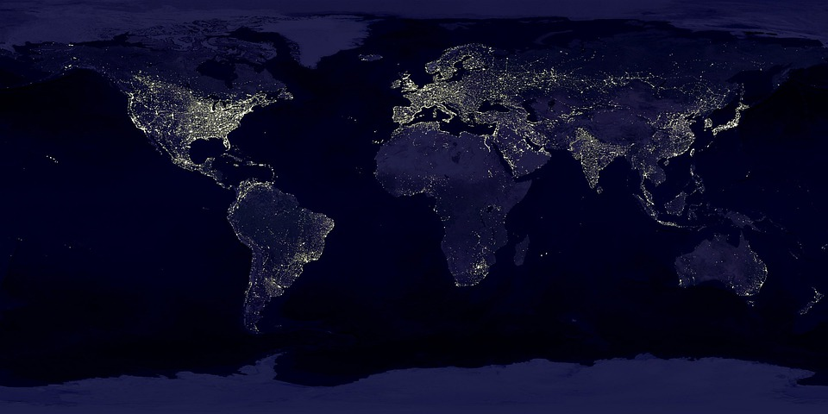
Travel Spy
Developers: Michael, Andrew, & Gassan

Slide 2
Elevator pitch
A travel website that helps you decide where you want to go next
The goal of our web application is to provide the consumer with a one-stop shop for travel
It provides you with multiple types of data relating to the destination of your choice
With a fresh and new theme where you have your own personal spy
You no longer need to use multiple websites to plan your next trip, just use Travel Spy

Slide 3
Travel Spy Concept
Travel Spy: an all-inclusive website for all your travel needs and plans
Our team decided to develop this website after experiencing difficulties during our own personal travel experiences so we decided to simplify the process by developing a website that would give you absolutely everything you need to plan your next trip.
User story: As a traveler, I need a web application that will give me all the information I need to plan my vacation efficiently
Notes:
Acceptance Criteria:
Given a list of destination options
When I click a destination
Then I am presented with an option to deploy or change location
When I deploy
Then I am presented with the destination name, country flag, currency exchange rate, current date and time in that country, and sightseeing options

Slide 4
Process
Technologies used: Tailwind CSS, country flag API, currency exchange API, hotels API, REST Countries API, and time zone API
Breakdown of tasks and roles:
Michael: setting up our repository, writing HTML, structuring the JavaScript, and implementing the country flag API and country data to create functions
Andrew: implementing the use of Tailwind CSS into our page and implementing the currency exchange API, and the time zone API
Gassan: using Tailwind CSS to style the website, writing HTML, implementing the hotel API (work in progress), and creating the presentation.
Challenges: API key, user input, non-specific return data
Successes: use of Tailwind, JavaScript workarounds on API’s, and the 3 team member effort to work together to develop our website

Slide 5
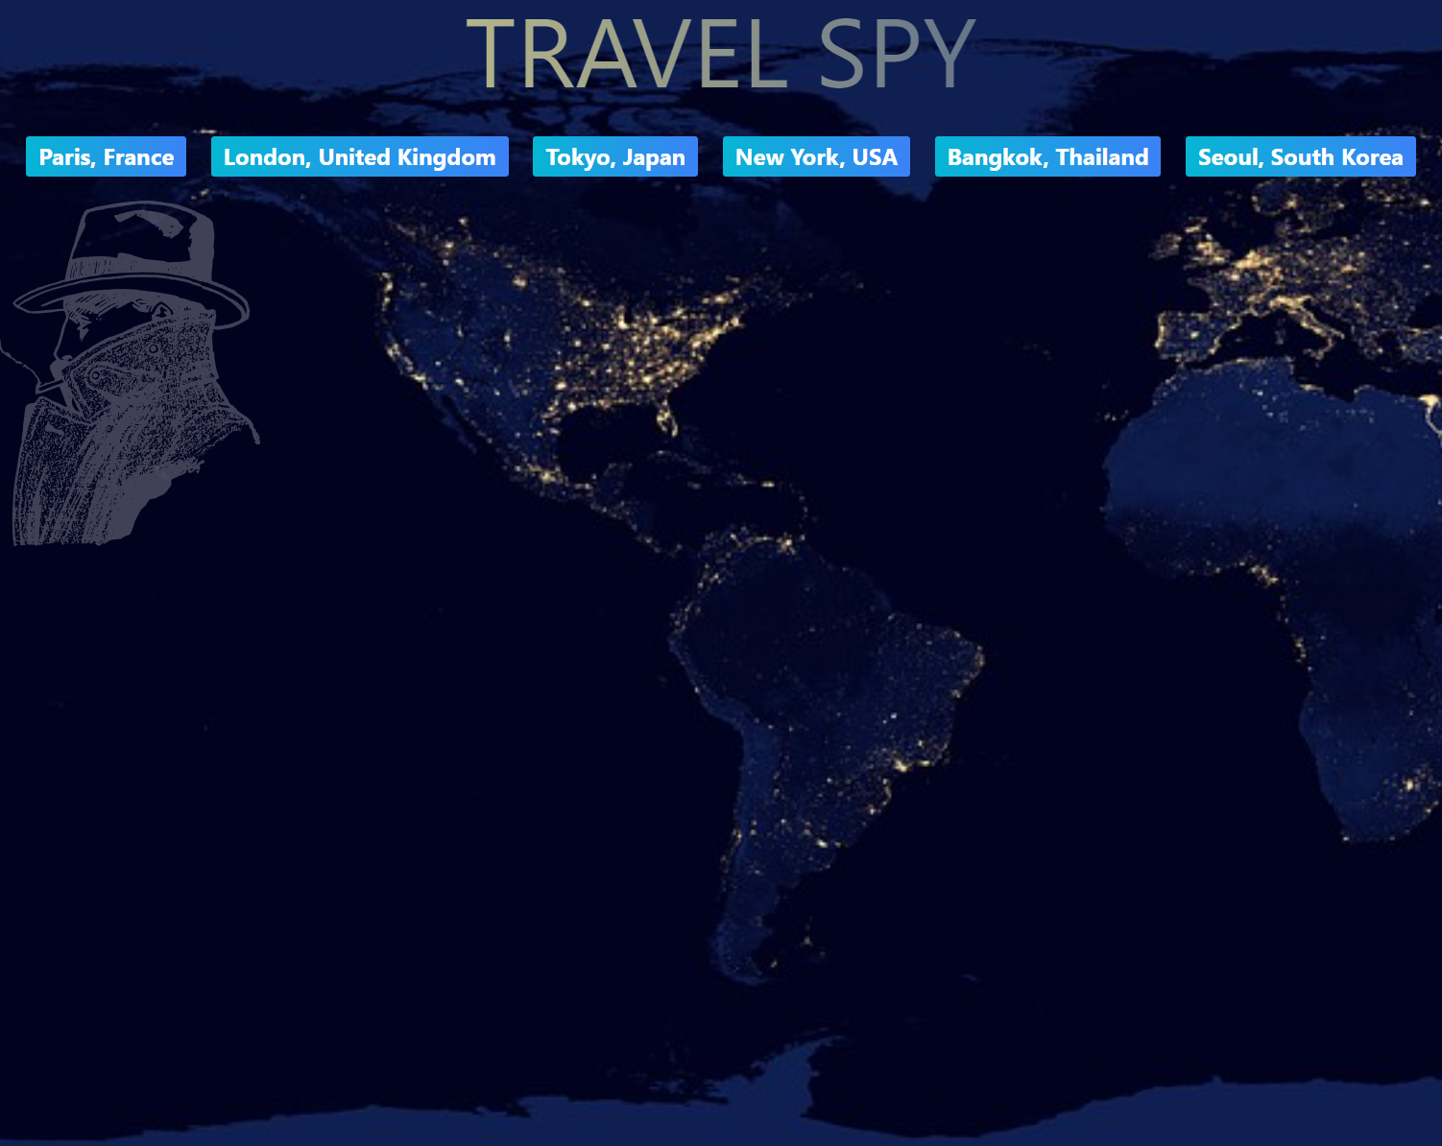
Demo: Michael will now share the website

Slide 6
Directions for Future Development
In the future we would like to continue development to expand the website
Adding options for:
Best times to visit
Hotels options
Transportation services
Detailed sightseeing options
What to pack
Language translation
General travel hacks

Slide 7
Links
Deployed: https://mjbauti.github.io/TravelSpy-TravelPrepWebsite/index.html
GitHub repo: https://github.com/MJBauti/TravelSpy-TravelPrepWebsite

